Slide 1
Poles 101
Pole Components

Slide 2

Objectives
Understand common pole components
Foundations
Bases and Covers
Pole Types
Handholes and Festoons
Arms
Attaching Fixtures and Accessories
Complete the Final Assessment

Slide 3
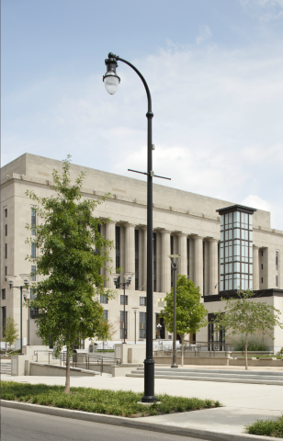
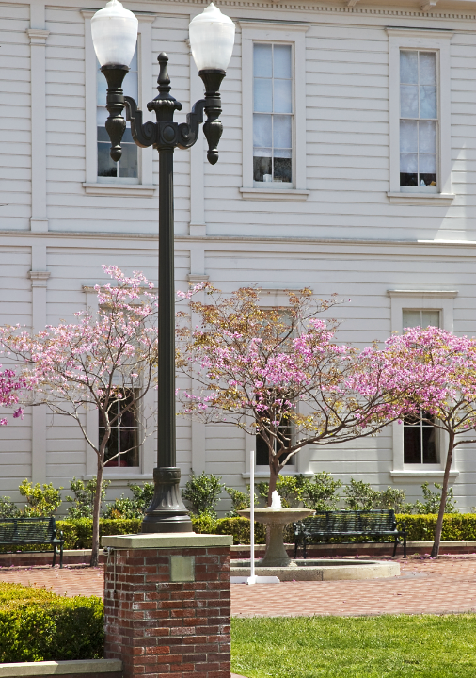
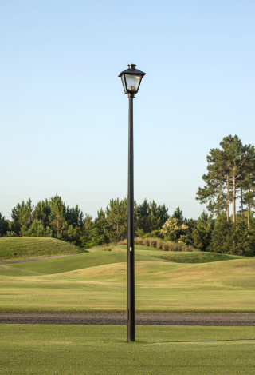
Foundation Types
Anchored
Anchored: Pedestal
Embedded

Slide 4
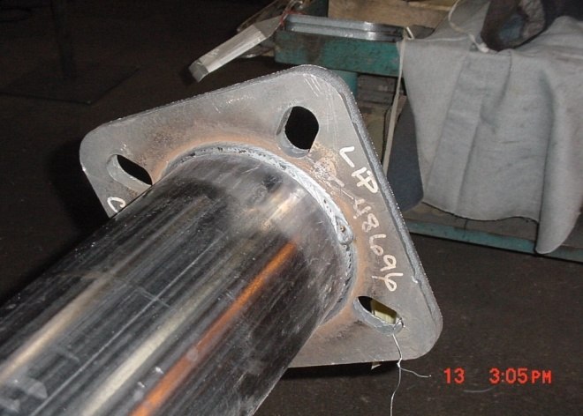
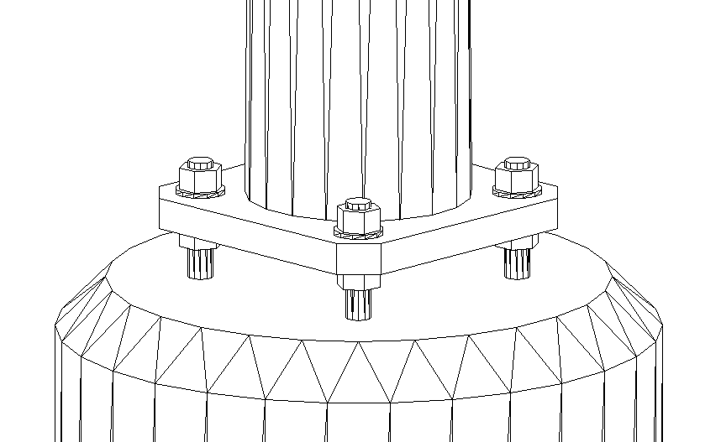
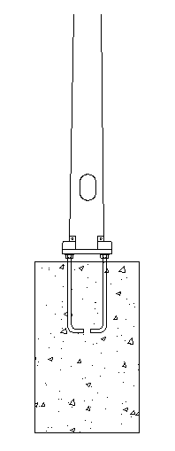
Anchored
Bolt Covers
Foundation Base
A base plate is welded to the bottom of the pole shaft. The base plate is then bolted to anchor bolts that project out of the concrete foundation.
Anchor Bolt
Concrete Foundation
Top Nut and Washer
Base Plate
Bottom Nut and Washer
Pedestal
Mount

Slide 5
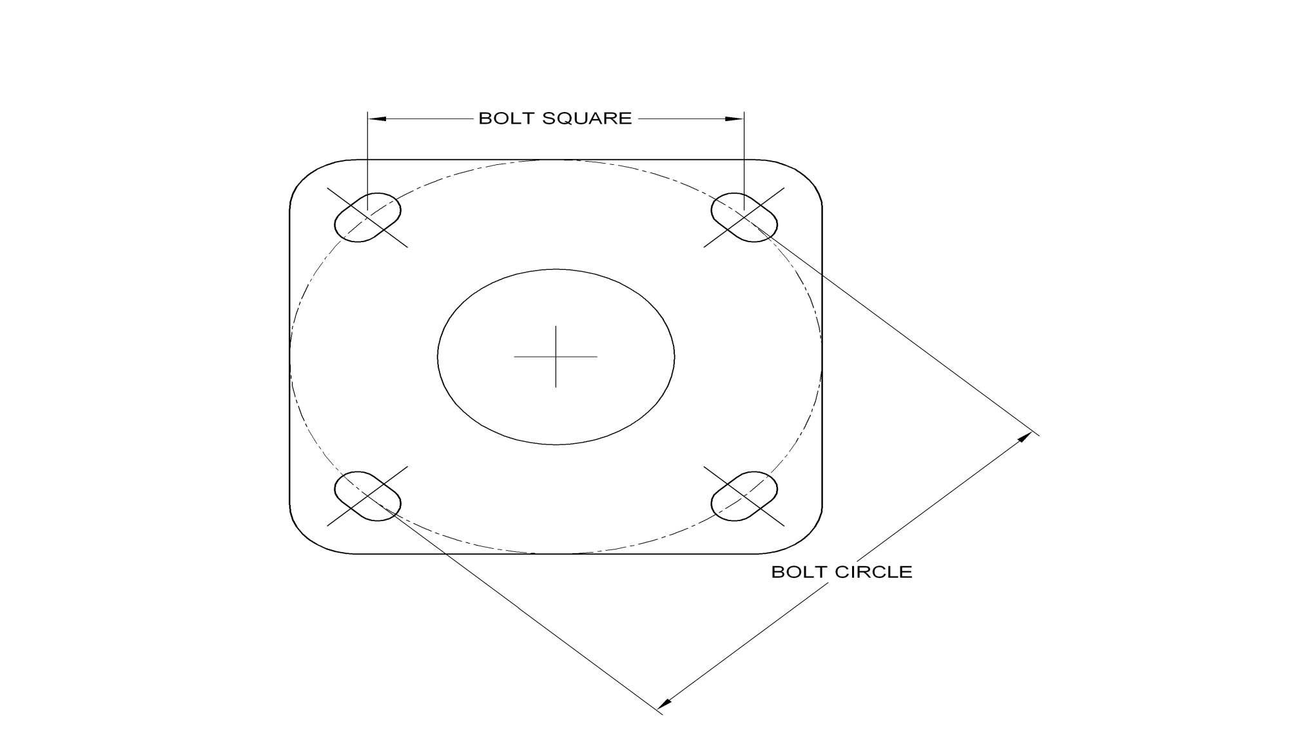
Anchored
Base Plate
The base plate must align with the anchor bolts. The bolt alignment can be measured in two ways: Bolt Square, and more commonly, Bolt Circle.

Slide 6
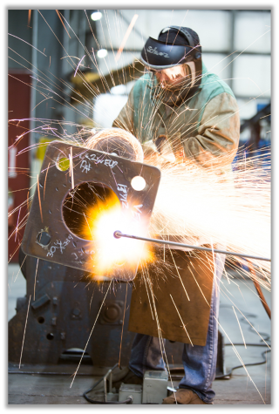
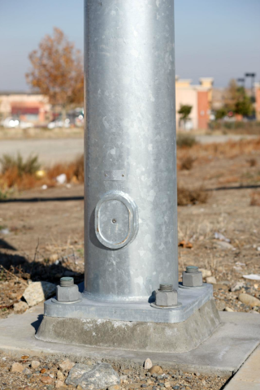
Anchored
Base Plate
Steel base plates can be manufactured to meet existing bolt circles. This allows for more customization and replacement options.
Base Plate
Base Plate

Slide 7
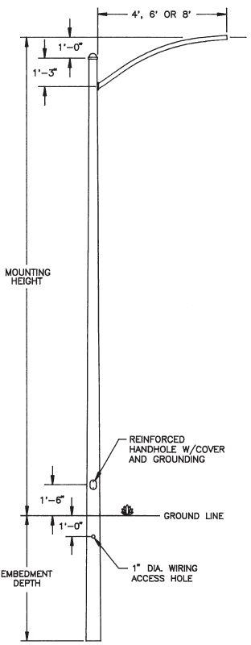
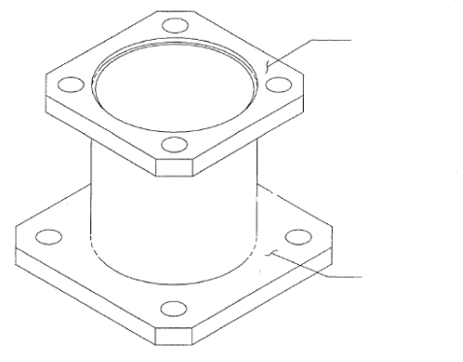
Other Foundation Options
Adapter Plate
Embedded Pole
Available for steel and aluminum, adaptor plates will allow you to add a smaller pole to a larger existing bolt circle.
Embedded poles are poles that are held in place by partially burying them in the ground. The poles can be backfilled by stone, soil, or in extreme conditions, a concrete base.
Steel embedded poles should be galvanized and CorroCoated (coal tar) on the embedded portion for greater corrosion resistance.

Slide 8
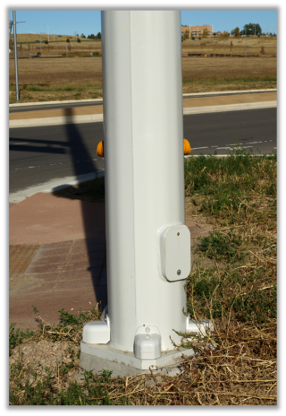
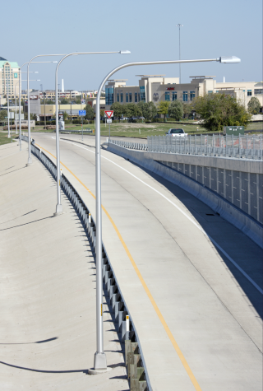
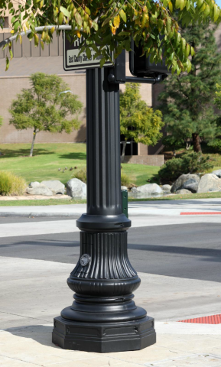
Bases and Covers
Nut Cover
Transformer Base
Decorative Base

Slide 9
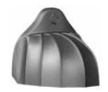
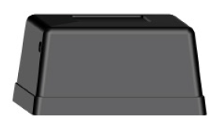
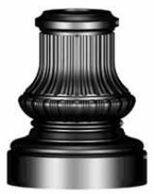
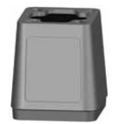
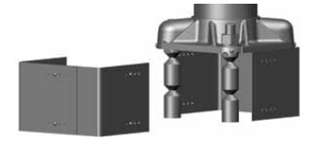
Bases and Covers
There are a variety of ways to cover up the anchor bolts and/or the base of the pole. Simple screw on options begin with nut covers, and solutions can become more complex with T-bases, and decorative and breakaway options.
Nut Cover
Standard Base
Transformer Base
Decorative
Base
Breakaway
Base

Slide 10
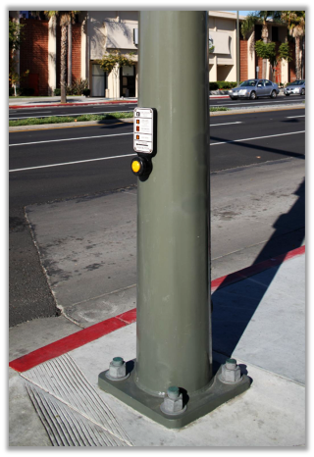
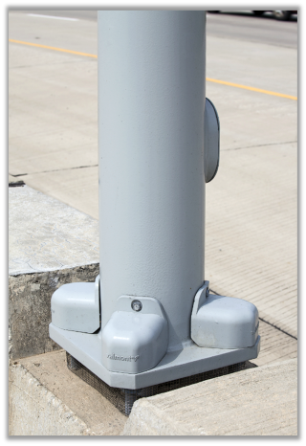
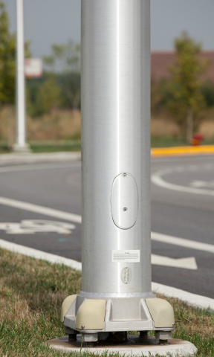
Bases and Covers
Purpose 1 – Safety
Bases and nut covers serve two very important purposes. The first purpose is to cover the anchor bolts. This reduces human injury in high volume pedestrian areas.
Aluminum poles come with a standard “shoe base” base plate and nut cover set up.
Hazard

Slide 11
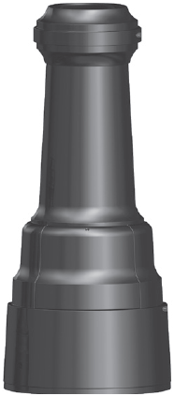
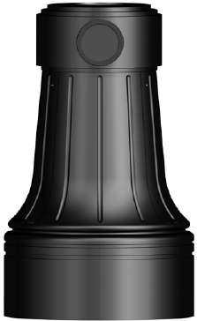
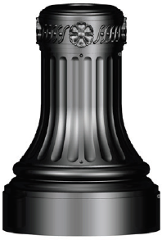
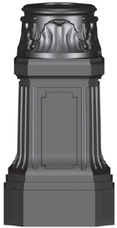
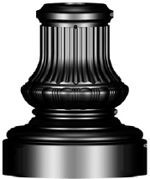
Bases and Covers
Purpose 1 – Safety
Breakaway bases also provide safety. These are often used in high volume traffic areas.
These bases will break off at the sheer points and allow the pole to collapse. This reduces the likelihood of injury to drivers/passengers in a car accident.
Valmont has five decorative breakaway bases approved by the Federal Highway Administration (FHWA).
Sheer here

Slide 12
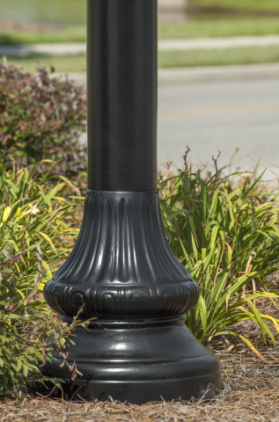
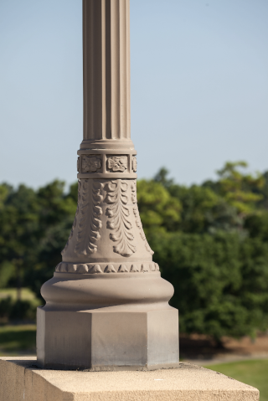
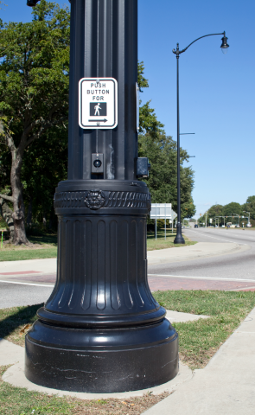
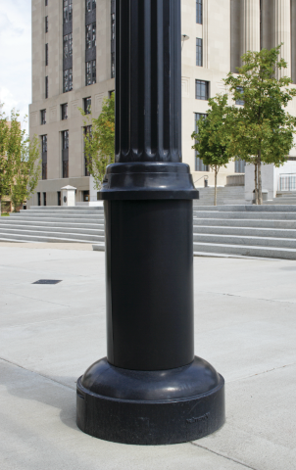
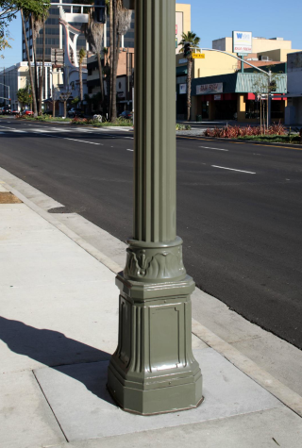
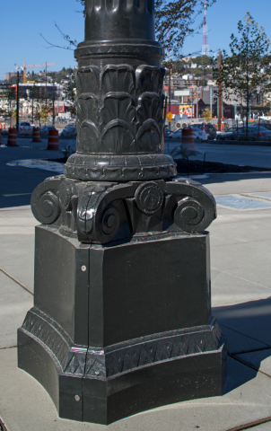
Bases and Covers
Purpose 2 - Design
The second purpose is purely aesthetic. The base can add significant street appeal and can help ‘ground’ the pole.
Valmont provides dozens of catalog options for standard and decorative bases. Custom bases can also be manufactured by request.

Slide 13
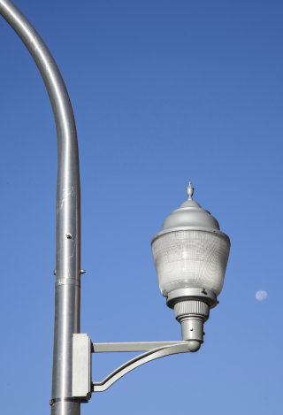
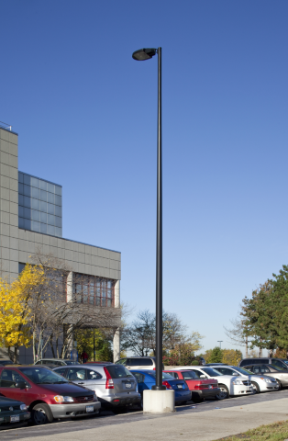
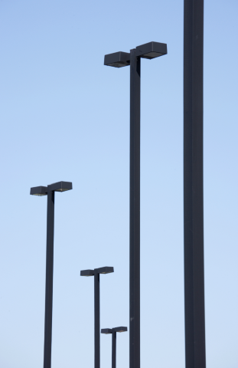
Pole Types
Materials
Round
Square

Slide 14
Pole Material – Steel and Aluminum
Steel
Aluminum
Both
Benefits:
Strength
Less susceptible to vibration
Fabricated base plates
Cost effective at taller mounting heights (above 30’)
Recyclable with low scrap value
Drawbacks:
Corrosive
Heavy – more equipment to install
Benefits:
Corrosion resistant
Light – easy to handle
Flexibility in tapering
Cost effective at lower mounting heights (below 30’)
Drawbacks:
Vibration or fatigue
Damper required on taller or bridge mounted poles
Cast base plates – no customization
Recyclable with high scrap value – damage or theft
Benefits:
Buy America compliant
Multiple shapes available
Multiple finish options

Slide 15
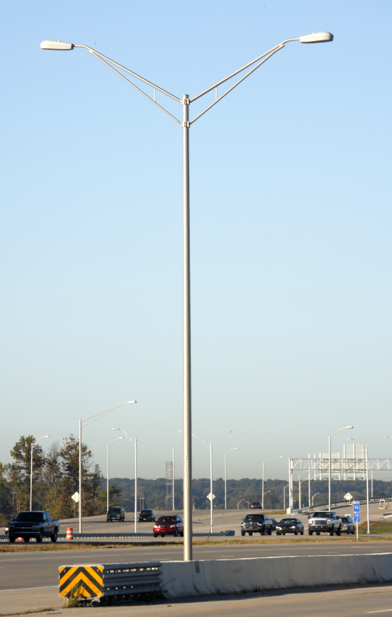
Round Tapered
Benefits
Drawbacks
Available in steel (RTS) and aluminum (RTA)
Taller mounting heights - Up to 70 Feet
Able to vary wall thickness of sections
Potentially fewer poles required
Variety of finishes
Will handle substantial loading
More expensive than straight rounds

Slide 16
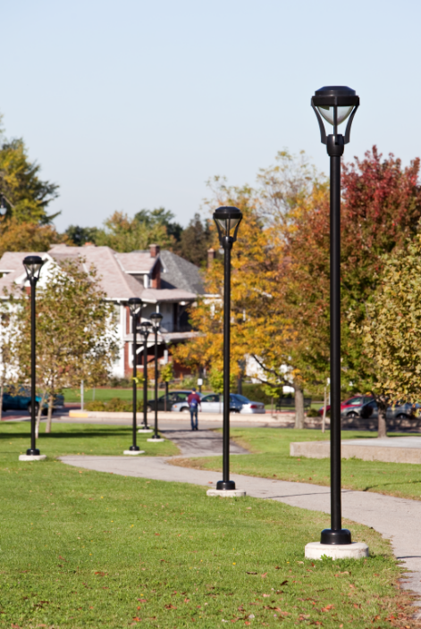
Straight Round
Benefits
Drawbacks
Available in steel (SRS) and aluminum (RNTA)
Price effective
Variety of finishes
Readily available
Less prone to vibration problems
Height limitations
Loading limitations

Slide 17
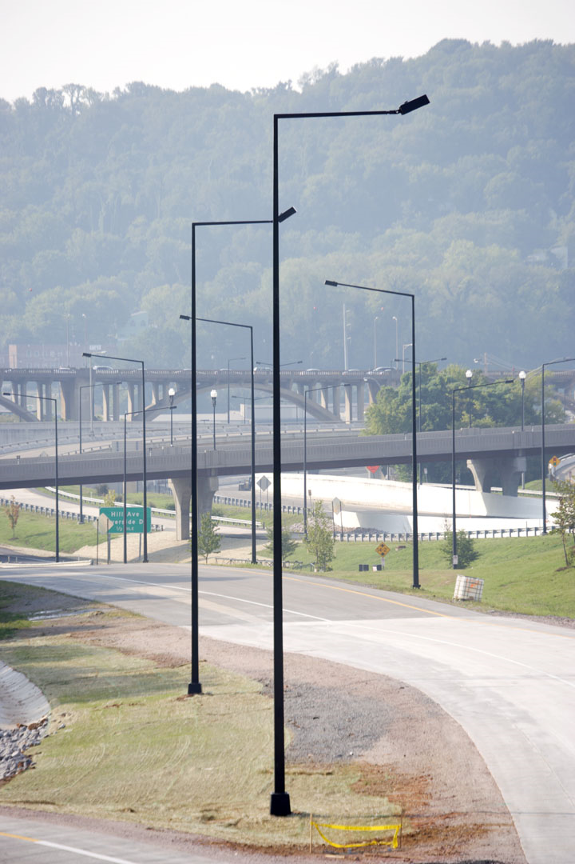
Square Tapered Steel
Benefits
Drawbacks
Sleeker square pole aesthetics
Variety of finishes
Taller mounting heights - Up to 50 Feet
Will handle more loading than Straight Square
Limited competition
Spec lock opportunity
Only available in steel (STS)
More expensive than the Straight Square
Longer lead-times
Notes:
Common in area lighting – stay consistent
Blend area and street
50 will be 2 pieces – anything above 40’ check spec page

Slide 18
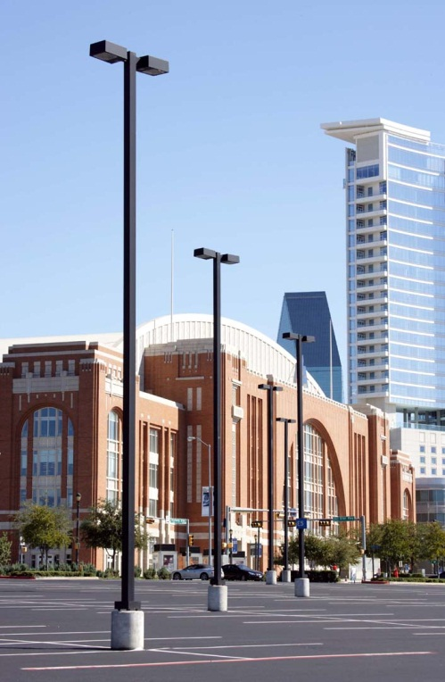
Straight Square
Benefits
Drawbacks
Available in steel (SSS) and aluminum (SNTA)
Price effective
Variety of finishes
Readily available
Height limitations
Loading limitations
Susceptible to vibration or fatigue

Slide 19
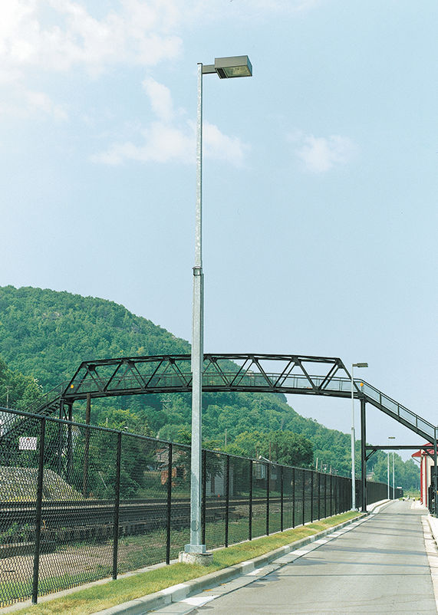
Hinged Poles
Benefits
Drawbacks
Available in aluminum for short poles and steel for taller applications.
Able to break-over pole to perform fixture maintenance.
Variety of finishes
Available with either internal, external, or base hinge
Limited competition – Spec lock opportunity
Height limitations – Up to 40 feet
More expensive
Longer lead-times
Prone to fatigue failure
Dimensions are fixed: no customization for heights or fixtures
Notes:
Not very common
Works well in tight spaces where you cant bring equipment
Spec options
Dimensions are fixed and cannot be custom

Slide 20
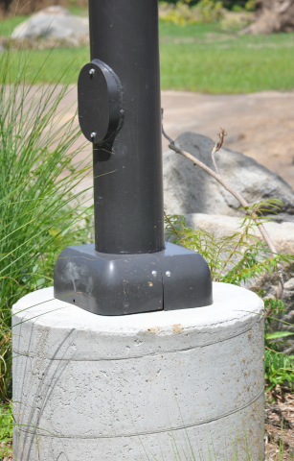
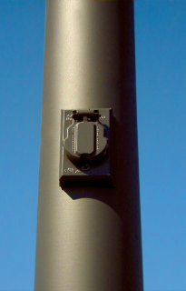
Handholes and Festoons
Steel Handhole
Aluminum Handhole
Festoon

Slide 21
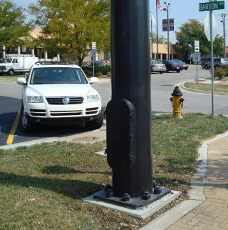
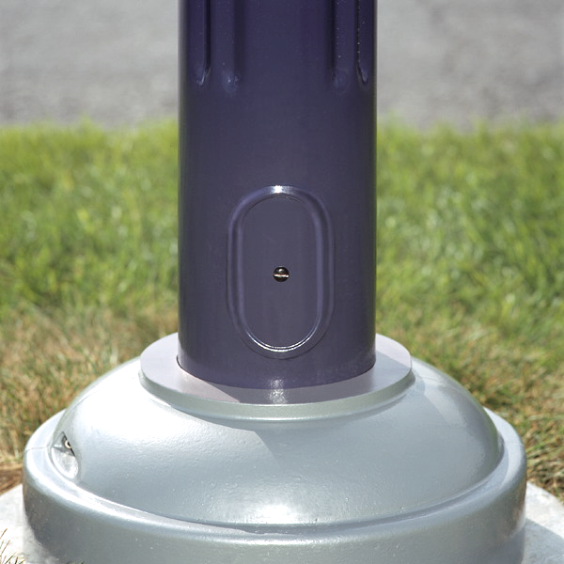
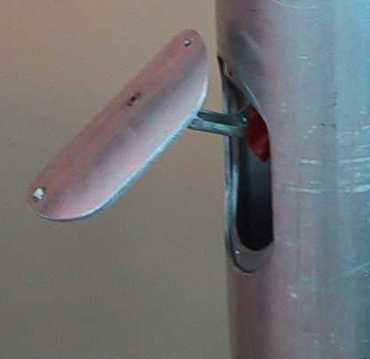
Handholes
1 - Reinforced
2 - Semi-Flush
3 - Hinged
Handhole Options
The purpose of the handhole is to allow the circuitry to be installed and repaired. Handholes come in standard sizes, however, larger reinforced handholes are available (picture 1). This gives the technician more room when servicing the pole.
General Valmont rule: the handhole will be placed 30” above anchor base and no closer to the pole top than 12” down.
1
2
3

Slide 22
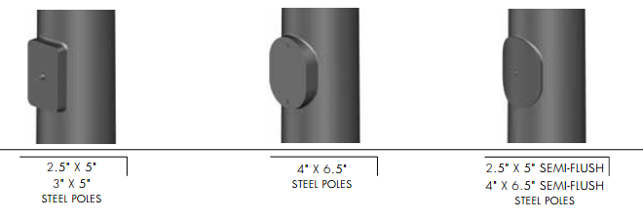
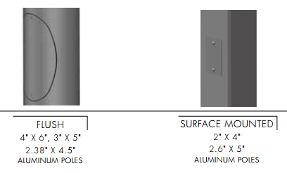
Handholes
Standard Steel Options
Standard Aluminum Options
*Can be UL Listed or UL Classified.

Slide 23
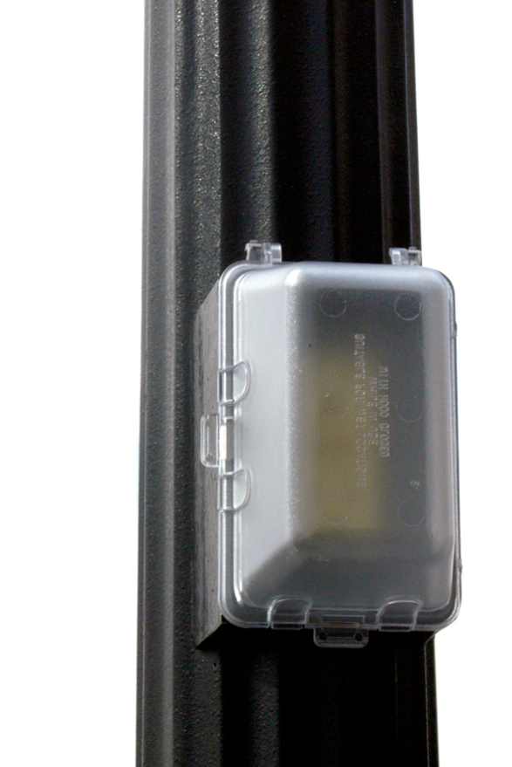
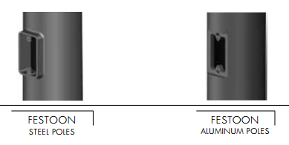
Festoon
Ground Fault Interrupter - GFI
Weather Resistant Cover
A GFI outlet can be installed as on option. GFIs can prevent electrical shock in wet locations. GFIs are often used on poles for decorations such as holiday lighting.
The weather resistant cover can be closed after the plugs are inserted.
*Can be UL Listed or UL Classified.

Slide 24



Arms
Arm Types
Standard
Decorative

Slide 25


Arm Types
A variety of arm types are available for different purposes. In traffic we have large Mast Arms that span long distances, often holding traffic signals. Luminaire Arms may be attached to these poles at an intersection, or lining a high-traveled street.
Pedestrian lighting is also an option. Posts and pedestrian scale arms/fixtures can be mounted on traffic poles to improve the safety of the pedestrians.
Mast Arm
Luminaire Arm
Pedestrian Scale Lighting Arm and Fixture

Slide 26

Standard Arms
You’ll notice these arms along roadways and high volume traffic areas.
The options shown here are steel, however, aluminum assemblies are available as well. Aluminum has Davit, Mast, and Truss options, allowing you to mix and match materials if you need to.
*The full product line is not represented.

Slide 27


Decorative Arms
Most decorative arms will be available in street and pedestrian scale.
Valmont has a wide range of decorative arms ranging from historic, traditional, to contemporary.
Custom arms can always be designed by the Valmont SWATT team.
*The full product line is not represented.

Slide 28


Scrolls
Scrolls add visual interest at an affordable price. Scrolls can be simple, like the bottom left, or complex like the image.
Pictured are the most common, but the options are endless.
*The full product line is not represented.

Slide 29

Attaching Arms
The way an arm is attached to a pole is dependent on how much loading is required. Some arms can be clamped onto the pole, while some are slip fitted or hub mounted. Also, some decorative arm options may be welded directly to the pole.
Most arms will require a simplex, however. These range in strength from a single bolt simplex, to a very strong 4-bolt simplex. Simplexes have one half welded to the pole, and the other half welded to the arm. Nuts and bolts then secure the arm in place.
You will see 4-bolt simplexes in most traffic signal applications.

Slide 30




Attaching Fixtures and Accessories
Drill Mount
Tenon
Finial
Couplings

Slide 31


Fixtures - Drill Pattern
Drill Mount
If a drill pattern is required, that means the fixture attaches directly to the pole. Drilling can be done on both square and round poles.
Drill mounts require fixture drill patterns to be supplied in the order process. There are hundreds of drilling types so if the drilling detail and photo are supplied, Valmont will drill the correct pattern in the shop, reducing field modifications.

Slide 32


Fixtures - Tenon
Tenon Mount
Tenons are designed for single luminaire lighting. They can adapt fixtures to pole tops that are larger than the slip fitter.
Tenons are welded to the top of the pole and the fixture sits on top of it. A set screw often locks the fixture in place.

Slide 33



Fixtures – Tenon + Bracket or Spoke
If the pole top diameter does not meet the bracket size, tenons can be top mounted to hold more than one fixture.
You can find these types of mounting styles in parking lots, and small scale sports lighting applications.
*The full product line is not represented.

Slide 34




Caps and Tops
Caps / Tops / Finials
The top of the pole can easily add a final touch to the design of the pole. Plastic push in caps are standard, and will come with any pole to reduce water and animal damage. Most finials will mount with set screws or bolts.
Dozens of finials and pole tops are available in the product catalog, however, custom pole tops can be designed.
*The full product line is not represented.

Slide 35



Couplings
Couplings
One of the most common accessories requested is the coupling. A coupling is a cylindrical piece of steel ranging in 0.50” to 4.00” in diameter with internal threads.
Some common uses for couplings include: crosswalk signals, lighting control boxes, and small banner arms.

Slide 36




Banner Arms, Flag Holders, and Plant Hangers
These attachments can be added to a pole in a variety of ways. Clamp, bolt, and coupling mounts are available for banners, flags, and plant hangers.
If you are planning on adding any of these, tell Valmont ahead of time so the pole can be designed to hold the additional weight.

Slide 37
FINAL ASSESSMENT
Three pole assemblies will be shown in the following slides. Arrows are pointing to components you learned about in this module. Use the Word Bank to answer the components in question. The next slide will reveal the answers.
Feel free to navigate backwards at any point to learn more about each component.
Let’s Begin

Slide 38

Complete Assembly 1
A:
C:
D:
What are these pole components?
WORD BANK
Tenon Mount
Fluted Round Tapered Pole
Pedestal Foundation
B:
Fixture
Decorative Base Cover
E:

Slide 39
Complete Assembly 1
Fixture
Tenon Mount
Fluted Round Tapered Pole
Decorative
Base Cover
Pedestal Foundation

Slide 40

Complete Assembly 2
A:
F:
B:
G:
C:
What are these pole components?
D:
WORD BANK
Decorative Base Cover
Traffic Fixture
Double Bolt Simplex
Fluted Round Tapered Pole
Festoon (GFI)
Banner
E:
Luminaire Arm
Pedestrian Scale Light – Fixture

Slide 41
Complete Assembly 2
Luminaire Arm
Traffic Fixture
Double Bolt Simplex
Festoon (GFI)
Pedestrian Scale Light – Fixture
Banner
Fluted Round Tapered Pole
Decorative
Base Cover

Slide 42

Complete Assembly 3
A:
C:
B:
D:
E:
What are these pole components?
F:
WORD BANK
Luminaire Arm
G:
Finial
Decorative Base Cover
Fluted Round Tapered Pole
H:
4 Bolt Simplex
Mast Arm
Scroll
Traffic Fixture

Slide 43
Complete Assembly 3
Traffic Fixture
Finial
Luminaire Arm
Scroll
Mast Arm
4 Bolt Simplex
Fluted Round Tapered Pole
Decorative Base Cover

Slide 44
THANK YOU!
valmontstructures.com

